Slide 1
Materialized Views vs Non-Materialized Views in Contemporary Database Management Systems
III (03 Cr. Hrs.)
1633
2016
01-07-2020
Shoaib Malik
160931 | Muhammad Zeeshan Anwar
161000 | Zoya Nadeem
Dr. Iqbal Murtaza
Imran Ihsan

Slide 2


Table of Contents
Introduction
Literature Review
Methodology
Project Flow
Results
Conclusion
Future Work
Demo

Slide 3
INTRODUCTION
A database is an organized collection of data that implements views to avoid:
re-computing complex results again and again
re-writing complex queries again and again
Non-Materialized view is a virtual table.
Materialized view is a physical table.
This study gives a comparison of materialized views vs. non-materialized views in contemporary database management systems

Slide 4
LITERATURE REVIEW
To best of our knowledge, no study exists which compares materialized and non-materialized views in contemporary database management systems.
However, some related work has been done in the past.
Optimizing Queries Using Materialized Views: A Practical, Scalable Solution (Jonathan Goldstein & Larson, 2001)
Optimizing Queries with Materialized Views (Sura jit Chaudhurix, Ravi Krishnamurthyy & Spyros Potamianosz, 2001)
Materialized Views (Rada Chirkova & Jun Yang, 2012)

Slide 5
METHODOLOGY
Generating Materialized
And Non-Materialized Views
Calculating Query Response Time
Displaying Results
Dataset Collection (TPC-DS)
CALCULATING QUERY RESPONSE TIME
01
02
03
04

Slide 6
DATASET

Slide 7
DATABASE MANAGEMENT SYSTEMS
We have used four database management systems:
Microsoft SQL Server
Postgres
SQL Anywhere
Oracle SQL Developer

Slide 8
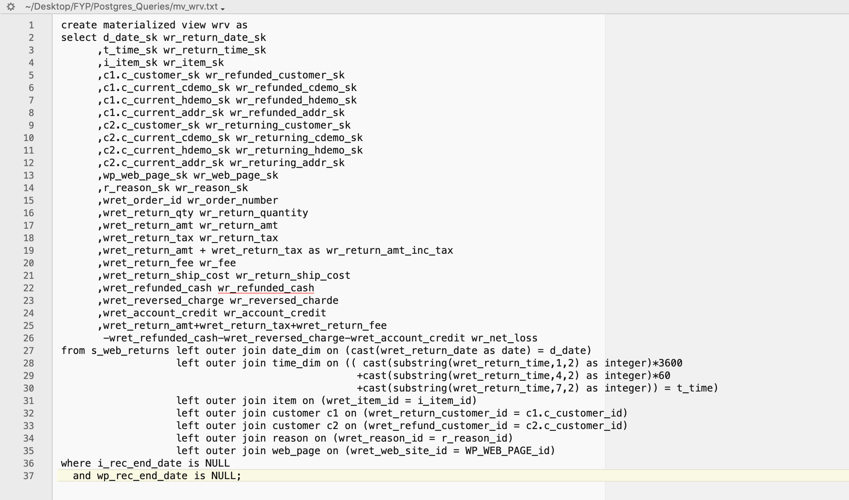
VIEW EXAMPLE

Slide 9
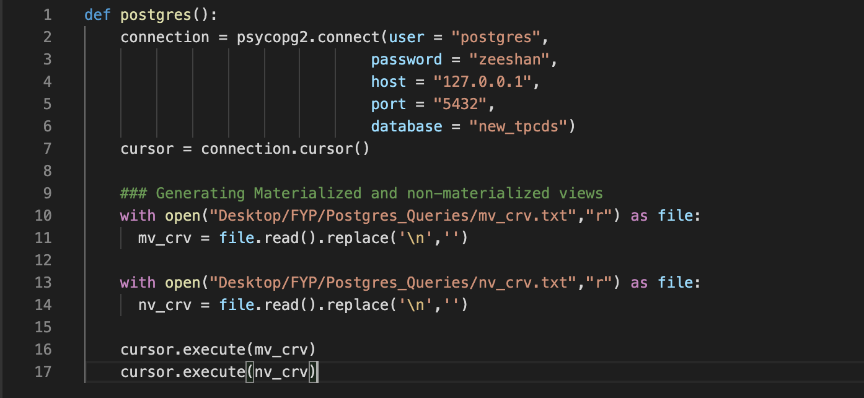
GENERATING VIEWS

Slide 10
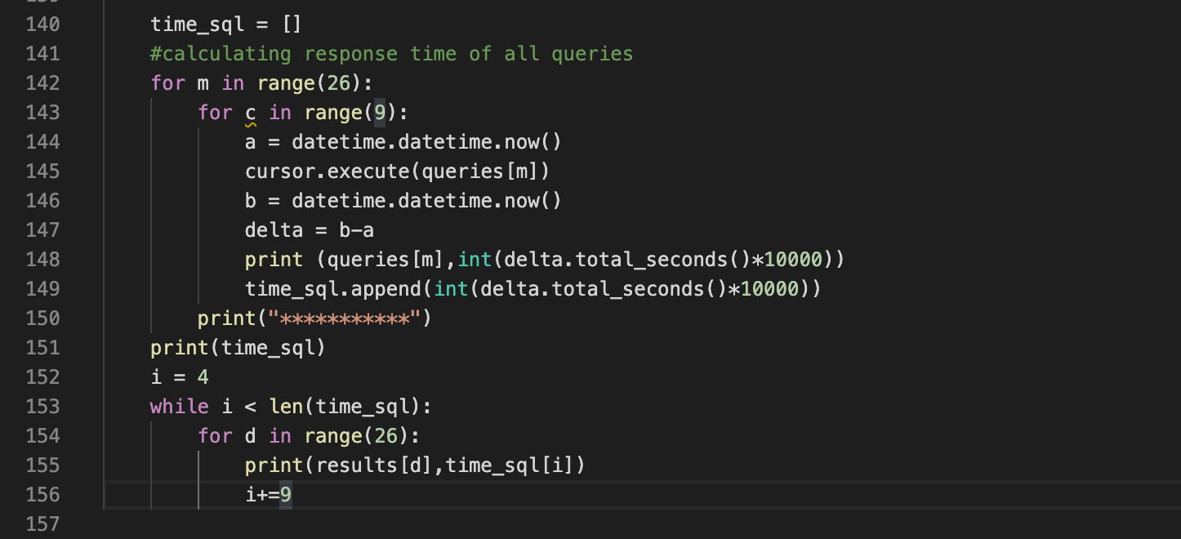
CALCULATING RESPONSE TIME

Slide 11
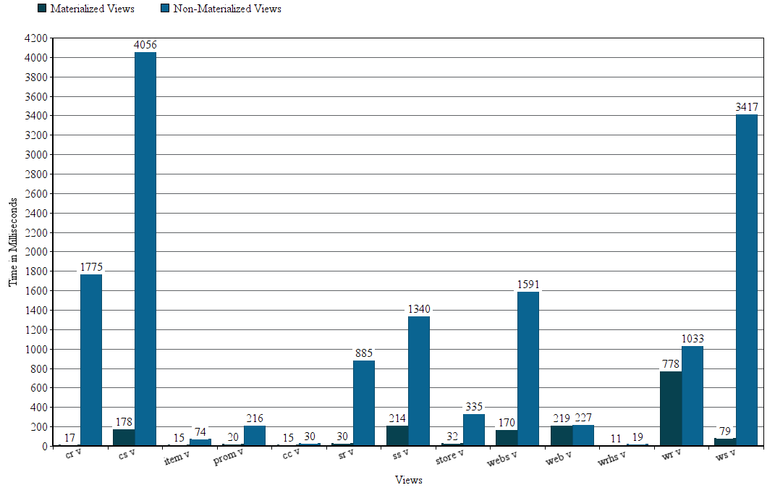
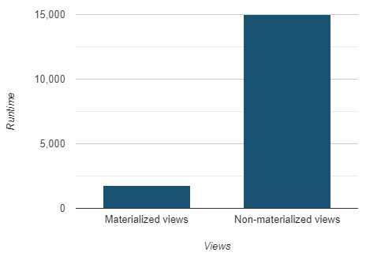
RESULTS
8.43 times better than non materialized views
Query Response Time for POSTGRES Materialized and Non-Materialized Views

Slide 12
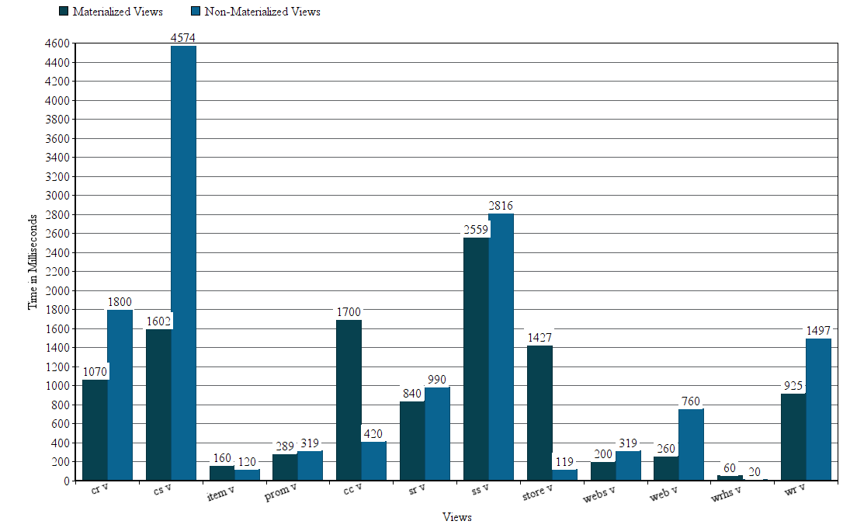
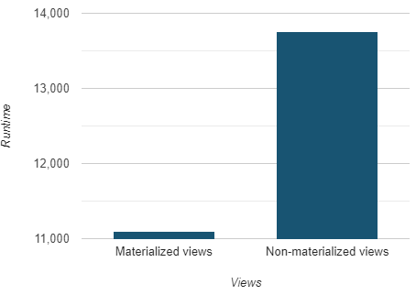
RESULTS
1.23 times better than non-materialized views
Query Response Time for SQL SERVER Materialized and Non-Materialized Views

Slide 13
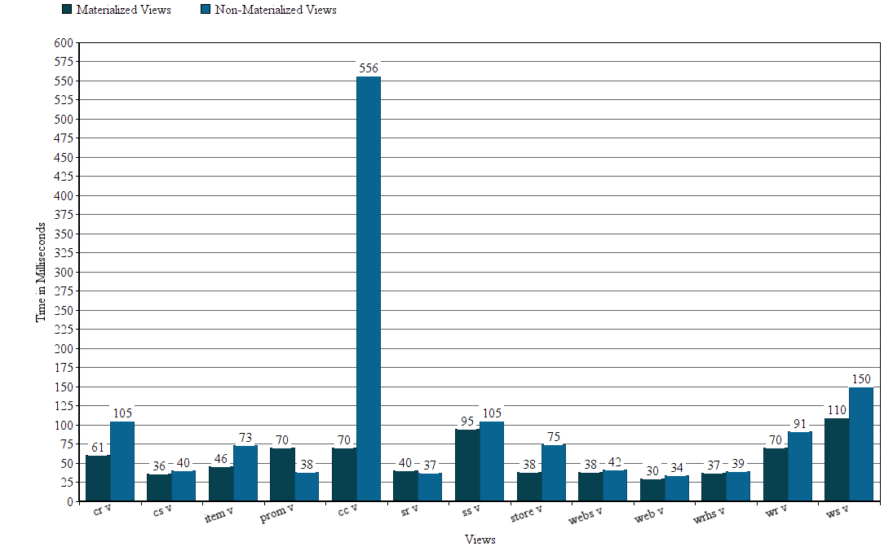
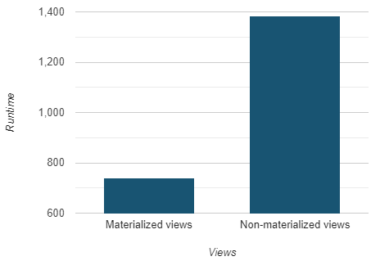
RESULTS
1.86 times better than non-materialized views
Query Response Time for SQL ANYWHERE Materialized and Non-Materialized Views

Slide 14
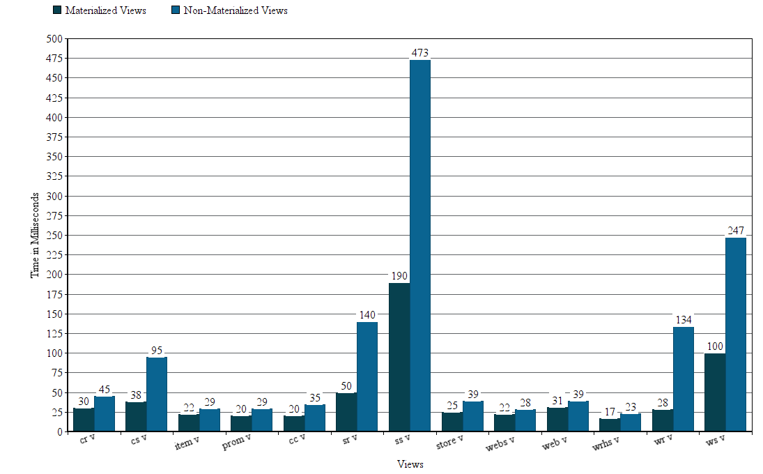
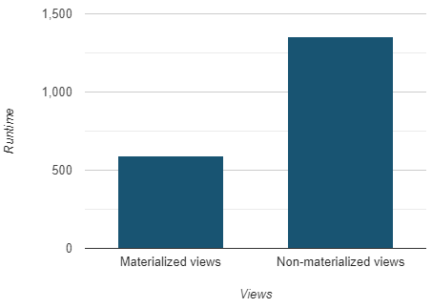
RESULTS
2.28 times better than non-materialized views
Query Response Time for ORACLE SQL Materialized and Non-Materialized Views

Slide 15
CONCLUSION
Materialized views performed better than non-materialized views in terms of select statements.
Fetching data from a materialized view is faster as compared to non-materialized views.

Slide 16
FUTURE WORK
Focusing on materialized views in terms of update statements.

Slide 17

DEMO

